Slide 1

Exploring the Zomato Restaurant Dataset
A comprehensive analysis guide for data professionals working with restaurant industry data, covering 57,421 menu items across six major Indian cities.

Slide 2
Dataset Overview and Structure
Dataset Dimensions
Data Quality Assessment
The Zomato dataset is a comprehensive collection containing 57,421 rows and 26 columns, representing individual menu items from restaurants across multiple Indian cities. This dataset provides a rich foundation for exploratory data analysis, enabling insights into restaurant performance, pricing strategies, customer preferences, and regional dining trends.
The dataset demonstrates excellent data completeness with zero null values across all 26 columns, which is relatively rare in real-world datasets. This completeness eliminates the need for imputation strategies and allows analysts to focus immediately on exploratory analysis and visualization.
The data types are appropriately assigned: 14 float64 columns for numerical metrics (ratings, prices, aggregated statistics), 6 int64 columns for count data (votes, binary flags), and 6 object columns for categorical information (names, locations, cuisine types). The memory footprint is manageable at 11.4+ MB, making it suitable for analysis in standard computing environments without requiring specialized big data tools.
The data structure includes categorical variables (restaurant names, cuisines, cities), numerical ratings (dining and delivery), pricing information, vote counts, and engineered features like popularity metrics and price-per-vote ratios. The dataset's granularity at the menu-item level offers unique opportunities to analyze not just restaurant performance, but specific dish popularity and pricing patterns.

Slide 3
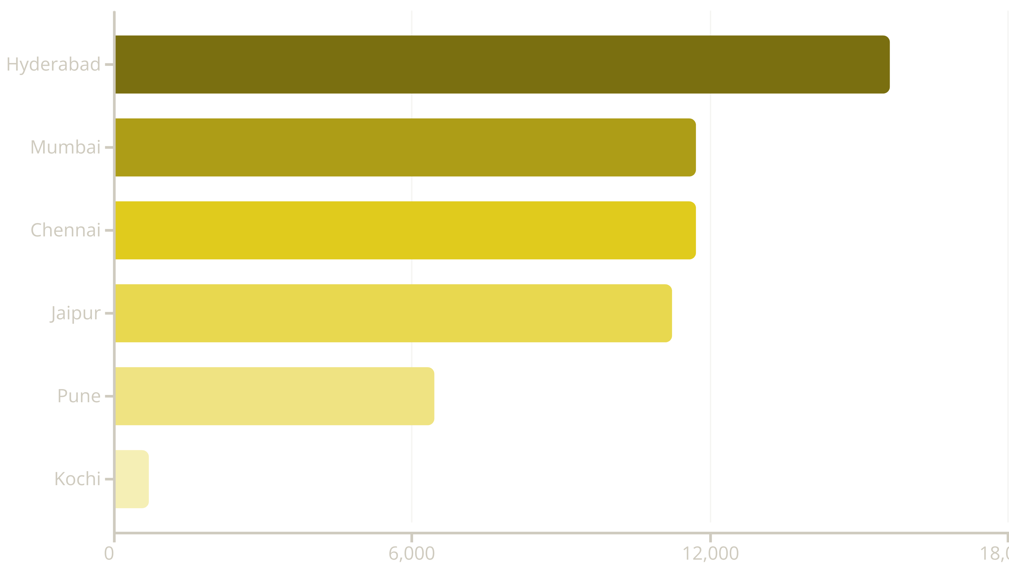
Geographic Distribution Analysis
The dataset covers six major Indian cities, with Hyderabad contributing the largest share at 27.2% of all menu items (15,613 items), followed closely by Mumbai (20.4%) and Chennai (20.4%). Jaipur represents 19.6% of the dataset, while Pune accounts for 11.2%. Kochi has the smallest representation at just 1.2% with 689 items.
This distribution suggests that the dataset may be skewed toward certain regional markets, which is an important consideration when drawing conclusions about national trends. The dominance of South Indian cities (Hyderabad, Chennai, Kochi combined represent 48.4%) and the presence of Western (Mumbai, Pune) and Northern (Jaipur) markets provides good geographic diversity, though analysts should be cautious about over-generalizing findings from Hyderabad, which alone represents more than a quarter of all observations.

Slide 4

Cuisine Diversity and Category Analysis
Cuisine Type Distribution
The dataset encompasses 39 distinct cuisine categories, revealing the diverse culinary landscape of Indian restaurant offerings. The top cuisine category is Beverages with 22,738 items (39.6% of the dataset), which makes sense given that beverages are offered across virtually all restaurant types and appear frequently on menus.
Desserts rank second with 5,503 items (9.6%), followed by Fast Food at 5,271 items (9.2%). Sichuan cuisine appears surprisingly prominent with 4,174 items (7.3%), indicating the popularity of Chinese-inspired dishes in Indian restaurants. Traditional Indian categories like Chinese (2,786), Biryani (2,573), and North Indian (1,466) also show strong representation.
Specialty cuisines are present but represent smaller segments: Shawarma (139 items), Turkish (22 items), Tibetan (20 items), and Kerala (10 items). This long-tail distribution is typical of restaurant data where staple categories dominate but niche offerings provide differentiation opportunities.
For visualization purposes, analysts might consider grouping the 39 cuisines into broader categories: Indian Traditional (North Indian, South Indian, Biryani, Mughlai, Hyderabadi, Lucknowi, Rajasthani, Kerala), Asian Fusion (Chinese, Sichuan, Tibetan), Quick Service (Fast Food, Street Food, Burger, Pizza, Sandwich), Beverages & Sweets (Beverages, Desserts, Ice Cream, Shake, Coffee, Mithai, Bakery), and International (Continental, Italian, Mexican, American, Turkish). This grouping strategy can simplify charts while preserving meaningful distinctions for business insights.

Slide 5



Rating Distribution Patterns
41
22
16
Unique Rating Values
Dining Rating Levels
Delivery Rating Levels
For Average_Rating across menu items
Distinct dining experience ratings
Unique delivery service ratings
Average Rating Distribution
Dining vs. Delivery Ratings
The Average_Rating variable shows 41 unique values, with the most common ratings clustering around 4.0 (4,951 occurrences), 3.95 (4,107 occurrences), and 4.1 (4,039 occurrences). This concentration suggests that most menu items receive above-average ratings, with a distinct skew toward the positive end of the scale.
Dining ratings display 22 distinct values, with notable concentrations at 3.822264 (15,967 occurrences), 3.8 (5,475), and 4.1 (5,191). The predominance of 3.822264 suggests this may be a default or calculated value applied to restaurants without specific dining data.
Delivery ratings show 16 unique values, clustering heavily around 4.1 (12,697 occurrences), 4.0 (8,585), and 4.2 (7,759). The delivery ratings trend slightly higher than dining ratings on average, which could reflect either genuine customer satisfaction differences between service channels or systematic bias in how delivery experiences are rated.
Interestingly, there's a peculiar rating value of 3.911132 that appears 2,730 times, along with similar decimal-heavy ratings like 3.961132 and 3.861132. These aren't standard user-facing ratings but likely represent calculated averages or aggregated scores from underlying data, indicating some form of data preprocessing or feature engineering has already occurred.
For analysis purposes, consider creating visualizations that compare dining vs. delivery ratings across different restaurant types, cities, or price points to uncover interesting patterns in service quality perceptions.
The ratings range effectively spans from around 3.2 to 4.6, with very few items rated below 3.0. This positive skew is common in restaurant data where establishments with consistently poor ratings may not survive long enough to accumulate many menu items in the dataset, creating a survivorship bias.

Slide 6
Pricing Dynamics and Patterns
Price Range Analysis
City-Level Pricing
Restaurant Price Variability
The dataset includes 1,780 unique price points, with the most common prices being ₹180 (1,032 items), ₹120 (1,009 items), and ₹200 (972 items). These round numbers suggest strategic pricing psychology at work.
Mumbai leads with the highest average city price at ₹304.40, followed by Chennai at ₹261.86 and Hyderabad at ₹245.13. Pune (₹242.17), Kochi (₹225.95), and Jaipur (₹217.16) show more moderate pricing.
With 410 unique average restaurant prices, there's substantial pricing diversity across establishments. The most common average restaurant price is ₹280.31 (700 items), indicating multiple restaurants cluster around this mid-range price point.
These city-level differences reflect local economic conditions, cost of living variations, and competitive dynamics in each market. Mumbai's premium pricing aligns with its status as India's financial capital with higher operational costs.
Price distribution shows a heavy concentration at common psychological price points (120, 150, 180, 200, 220), which is typical in restaurant pricing. The presence of odd decimal prices (421.68, 269.28, 97.46) likely represents post-tax or post-discount calculations.
The wide range from budget to premium pricing (₹93 to ₹428 average per restaurant) provides opportunities for market segmentation analysis and competitive positioning studies.
The Log_Price variable with 1,780 unique values suggests the dataset includes logarithmically transformed prices, which is useful for modeling as it can help normalize right-skewed price distributions and reduce the influence of extreme outliers in regression analyses.

Slide 7
Voting Behavior and Engagement Metrics
Dining Votes Analysis
Delivery Votes Analysis
The Dining_Votes variable shows 165 unique values, with a striking pattern: 21,984 items (38.3%) have zero dining votes. This substantial proportion of unvoted items suggests either newly added menu items, less popular dishes, or restaurants that primarily operate through delivery channels where dining feedback isn't collected.
Delivery_Votes presents 138 unique values, with an even more pronounced zero-vote pattern: 41,251 items (71.8%) have zero delivery votes. This overwhelming majority of unvoted items suggests that many menu items are rarely ordered for delivery or that the dataset includes restaurants that don't offer delivery services.
The most common non-zero dining vote count is 848 votes (844 occurrences), followed by modest engagement levels of 16, 32, and 4 votes. This creates a bimodal distribution with a large cluster at zero and smaller clusters at specific popular restaurants or signature dishes.
For items with delivery votes, the most common counts are 183 votes (700 occurrences), 819 votes (309 occurrences), and 940 votes (287 occurrences). These specific numbers appearing frequently might indicate aggregated data from restaurant chains or standardized reporting periods.
Higher vote counts (367, 482, 62) are rare, appearing only dozens of times, indicating that achieving significant dine-in engagement is challenging and typically reserved for established, popular establishments with strong foot traffic.
The Price_per_Vote metric shows 7,945 unique values, with common ratios at ₹180, ₹220, ₹150, and ₹120 per vote, providing a normalized measure of value perception that accounts for both price and popularity.

Slide 8
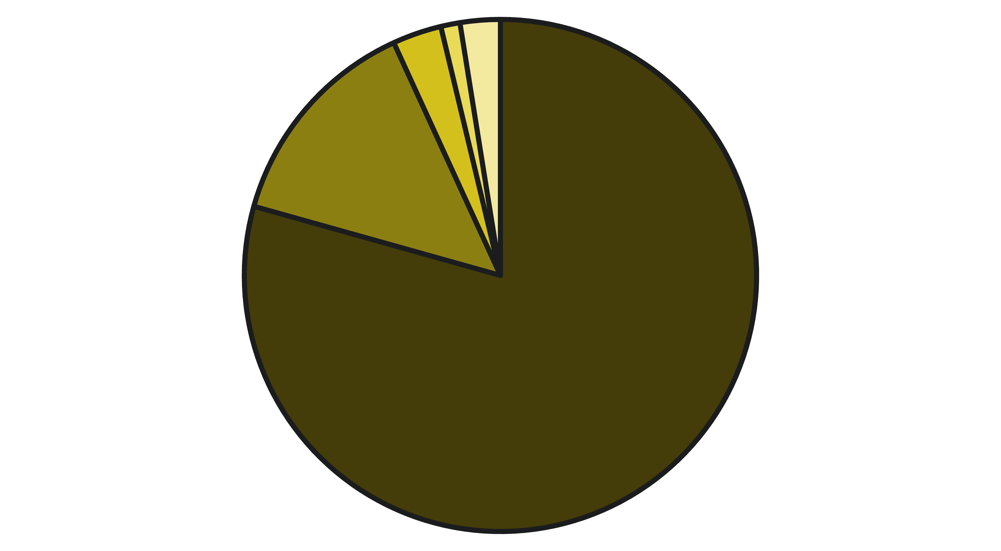




Best Seller Classifications and Menu Strategies
Standard Items
Bestsellers
Must Try
Chef's Special
Other Labels
The Best_Seller variable includes 14 distinct labels that restaurants use to highlight menu items, providing insight into merchandising strategies. The vast majority of items (79.4%) carry the "NONE" label, indicating standard menu items without special designation.
The "BESTSELLER" tag is applied to 7,930 items (13.8%), representing the most popular or highest-selling dishes that restaurants actively promote. "MUST TRY" appears on 1,777 items (3.1%), while "CHEF'S SPECIAL" designates 695 items (1.2%), suggesting signature creations or premium offerings.
NOT ELIGIBLE FOR COUPONS
SPICY
603 items (1.0%) - indicates premium or already-discounted items excluded from promotional offers
417 items (0.7%) - highlights heat level for customers with spice preferences
NEW
Dietary Labels
147 items (0.3%) - marks recent menu additions to drive trial and excitement
39 total items marked as VEGAN (17), EGGLESS AVAILABLE (10), GLUTEN FREE (6), FODMAP FRIENDLY (5), or DAIRY FREE (1) - catering to specific dietary requirements
Notably, the Is_Bestseller binary variable shows all 57,421 items coded as "1", suggesting this is a filtered dataset containing only bestseller-eligible items, or the variable definition differs from the Best_Seller categorical labels. This discrepancy warrants investigation before using this field in analysis.

Slide 9
Restaurant and Location Granularity
Restaurant Coverage
Geographic Granularity
The dataset spans 410 unique restaurants, with significant variation in menu representation. "The Momoz Hub" dominates with 700 menu items, followed by "Savoury Sea Shell" (595 items), "Raj Restaurant" (555 items), and "Capital Multi Cuisine Restaurant" (545 items). These high item counts suggest either large, diverse menus or potential data duplication issues that should be investigated.
Within the six cities, the dataset covers 144 distinct place names (neighborhoods or localities), with "C Scheme" in Jaipur leading at 2,287 items, followed by Mumbai's Chembur (1,826) and Hyderabad's Charminar (1,751). High-representation areas like Abids and Malakpet suggest established restaurant districts with dense commercial activity.
At the opposite end, numerous restaurants appear with just 4-9 items, such as Arabian food establishments and smaller specialty restaurants. This vast range in menu size (4 to 700 items per restaurant) indicates the dataset includes everything from focused quick-service establishments to comprehensive multi-cuisine restaurants.
Some localities have minimal representation: Deccan Gymkhana (4 items), Katraj (16 items), and Kora Food Street (20 items), which could indicate emerging restaurant areas, data collection gaps, or genuinely lower restaurant density in those neighborhoods.
This neighborhood-level granularity enables sophisticated spatial analyses, including clustering studies, competitive landscape mapping, and identification of underserved markets. Analysts can examine how restaurant characteristics, pricing, and ratings vary across different localities within the same city.
Restaurant_Popularity shows 230 unique values, likely representing a calculated metric that aggregates various engagement signals. This engineered feature provides a convenient single metric for ranking and comparing restaurants across the dataset.

Slide 10




Engineered Features and Analysis Opportunities
Binary Classification Variables
Aggregated Metrics
Is_Highly_Rated (2 unique values) identifies menu items or restaurants exceeding quality thresholds, with 41.0% (23,556 items) marked as highly rated. Is_Expensive flags premium-priced items, with 27.7% (15,881 items) in the expensive category. These binary features are ready-made for classification modeling and segmentation analysis.
The dataset includes pre-calculated aggregation fields: Avg_Rating_Restaurant (69 unique values), Avg_Price_Restaurant (410 values), Avg_Rating_Cuisine (40 values), Avg_Price_Cuisine (39 values), Avg_Rating_City (6 values), and Avg_Price_City (6 values). These enable multi-level comparative analysis without requiring complex aggregation queries.
Popularity and Engagement
Item-Level Detail
Total_Votes (258 unique values) combines dining and delivery votes, while Restaurant_Popularity (230 unique values) provides a composite popularity score. These metrics facilitate ranking, trending analysis, and identification of engagement drivers. The Price_per_Vote ratio offers a value-perception index for comparing items across different price points.
Item_Name contains 30,302 unique dishes, with "Paneer Butter Masala" being the most common (176 occurrences), followed by "Veg Fried Rice" (169) and "Chicken Fried Rice" (160). This granularity enables dish-specific popularity analysis, seasonal trend identification, and menu optimization recommendations based on successful items across restaurants.
Key Analytical Opportunities
Predictive Modeling: Use ratings, prices, votes, and categorical features to predict restaurant success, dish popularity, or customer satisfaction scores
Market Segmentation: Cluster restaurants by cuisine, price point, location, and performance metrics to identify distinct market segments and competitive positioning opportunities
Pricing Strategy Analysis: Examine price elasticity, optimal price points by cuisine and location, and price-quality perceptions across market segments
Geographic Intelligence: Map restaurant density, analyze underserved neighborhoods, and identify expansion opportunities based on location-specific performance patterns
Menu Optimization: Identify high-performing dishes, analyze cross-selling opportunities, and recommend menu engineering strategies based on popularity and profitability proxies
Quality Benchmarking: Compare restaurant performance against cuisine averages, city averages, and overall dataset benchmarks to identify over- and under-performers

Slide 11
Executive Overview
Understanding the Data Landscape
This analysis examines a comprehensive dataset containing 39,638 restaurant records spanning multiple cities, with detailed metrics on consumer engagement, pricing structures, and service performance. The data reveals critical patterns across 619 unique voting distributions and 258 distinct vote count categories, providing robust statistical power for market opportunity identification.
Key Analytical Metrics
Consumer Engagement: Total votes, dining votes, delivery votes
Quality Indicators: Average ratings across dining and delivery channels
Market Saturation: Restaurant counts, highly-rated establishment density
Our analytical framework evaluates three strategic dimensions: Cuisine Performance, Geographic Market Potential, and Service Channel Optimization. Each dimension combines multiple performance indicators to surface actionable insights for market entry and expansion decisions.
Economic Factors: Average pricing by cuisine, city, and restaurant
Performance Segments: Bestseller status, high-rating classifications

Slide 12

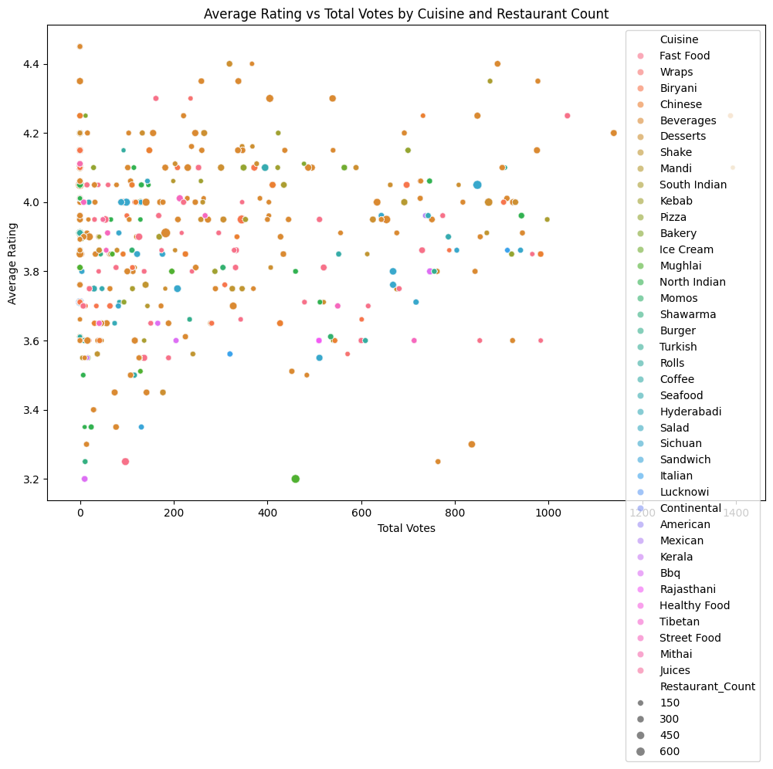
Cuisine Analysis: Identifying High-Potential Categories
The cuisine landscape reveals significant variation in market saturation, consumer demand, and quality perception. Our analysis identifies white-space opportunities where high ratings and strong consumer engagement intersect with lower competitive density.
High-Demand Cuisines
Quality Leaders
Cuisines with elevated total votes demonstrate proven consumer interest and market validation. These categories show sustained engagement patterns indicating reliable demand streams for new market entrants.
Categories achieving higher average ratings (4.0+) signal consumer satisfaction and repeat visit potential. Quality perception directly correlates with pricing power and brand loyalty development.
Low Competition Zones
Markets with fewer established restaurants present reduced competitive pressure. Combined with strong ratings and votes, these represent optimal entry opportunities for differentiated concepts.

Slide 13
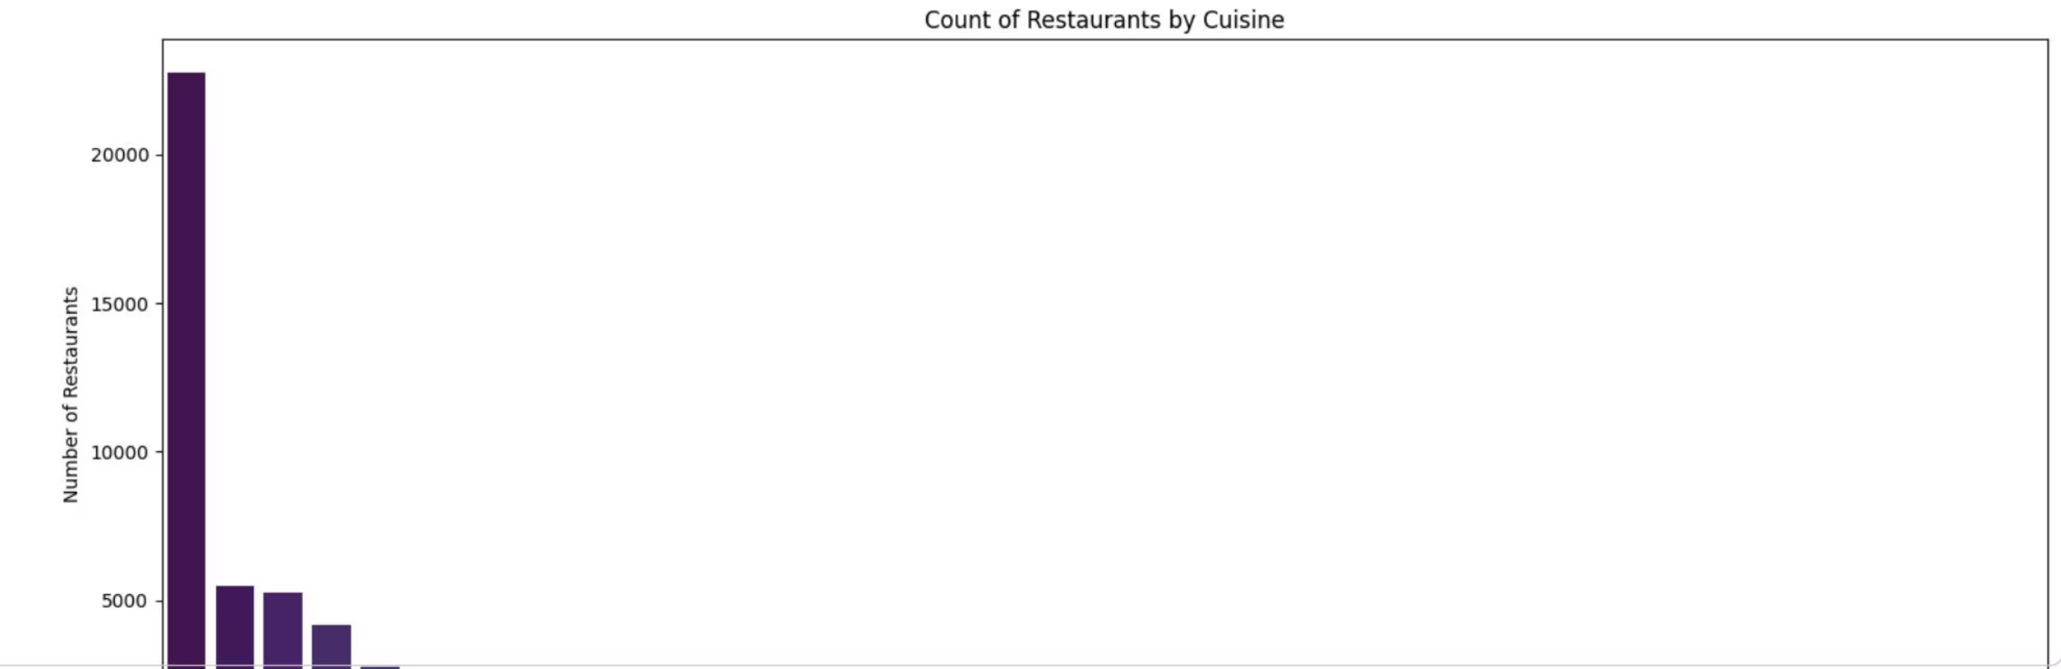
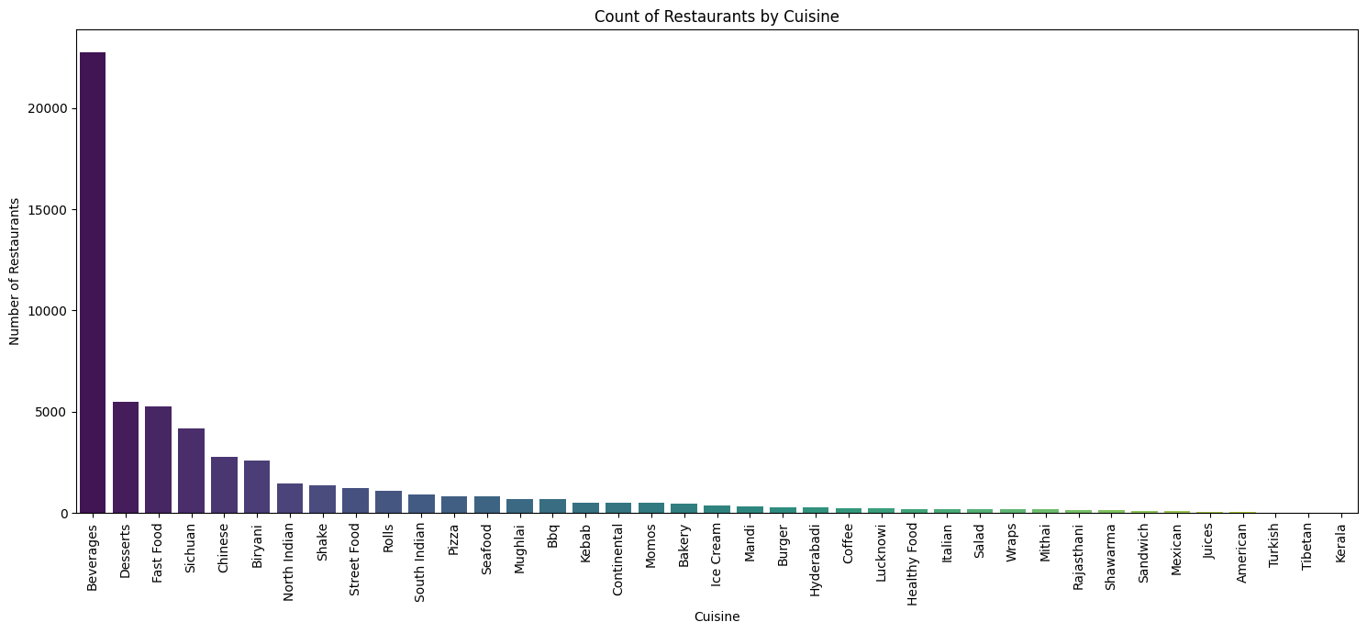
Market Saturation by Cuisine Category
The restaurant count distribution reveals significant market concentration in traditional categories while emerging cuisines remain underserved. Chinese cuisine dominates with the highest restaurant count, followed by North Indian and Continental offerings. This concentration pattern suggests mature market dynamics in popular categories.
Strategic Implications
Avoid oversaturated Chinese and North Indian segments unless offering radical differentiation
However, specialty cuisines including BBQ, Burger, Biryani and Bakery segments show moderate representation, potentially indicating growth opportunities for differentiated concepts within these categories. The long tail of niche cuisines (Beverages, American) presents white-space opportunities for first-mover advantage in underserved segments.
Target mid-tier categories with proven demand but manageable competition
Consider niche positioning in emerging cuisine types with lower entry barriers
Evaluate local preferences before committing to category selection

Slide 14
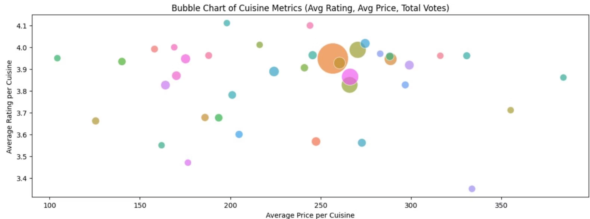



Price-Rating-Demand Dynamics
The bubble chart visualization maps the three-dimensional relationship between average pricing, quality ratings, and total consumer engagement across cuisine categories. Bubble size represents aggregate voting volume, serving as a proxy for market demand intensity.
Premium Positioning
Value Sweet Spot
Opportunity Zones
Cuisines in the upper-right quadrant command higher prices while maintaining strong ratings, indicating consumer willingness to pay for quality. These categories (Continental, American) demonstrate established value perception.
Mid-priced cuisines with ratings above 3.8 and large bubbles represent the optimal market position: proven demand, acceptable quality, and accessible pricing. Biryani and Bakery categories exemplify this balance.
Categories with high ratings but smaller bubbles may indicate undersupplied markets where quality execution could rapidly capture share. BBQ shows this pattern with strong ratings but limited total votes.

Slide 15
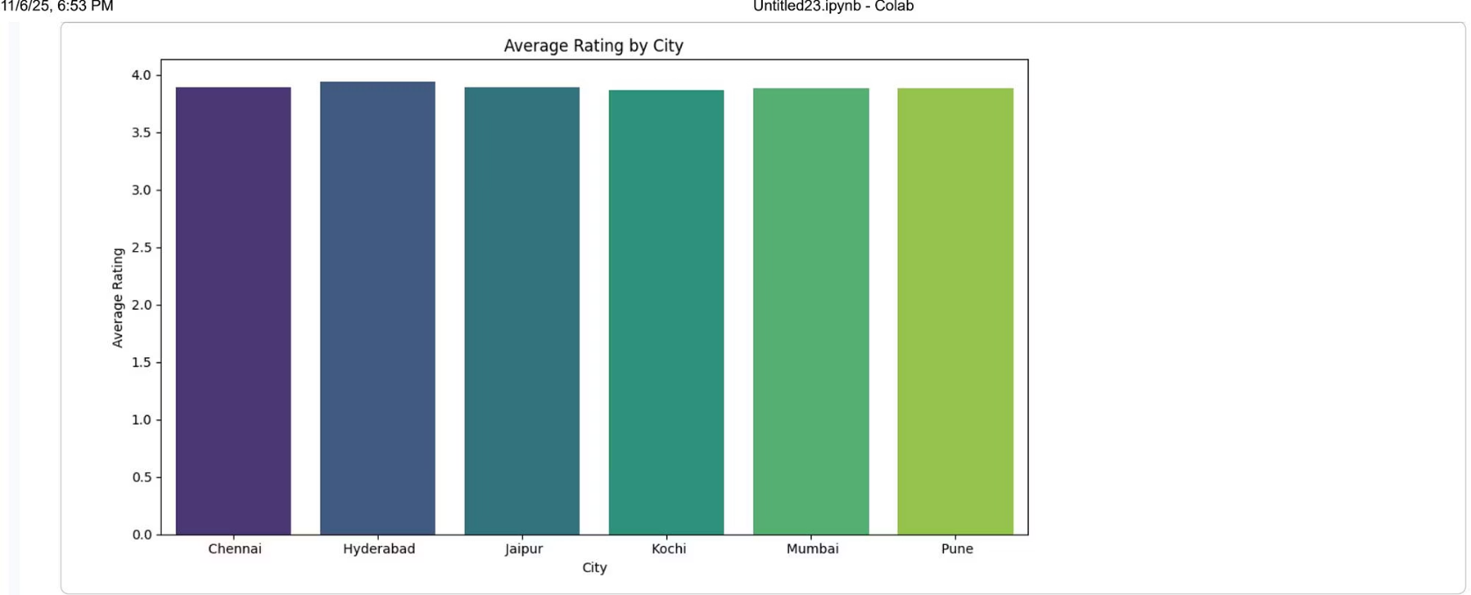
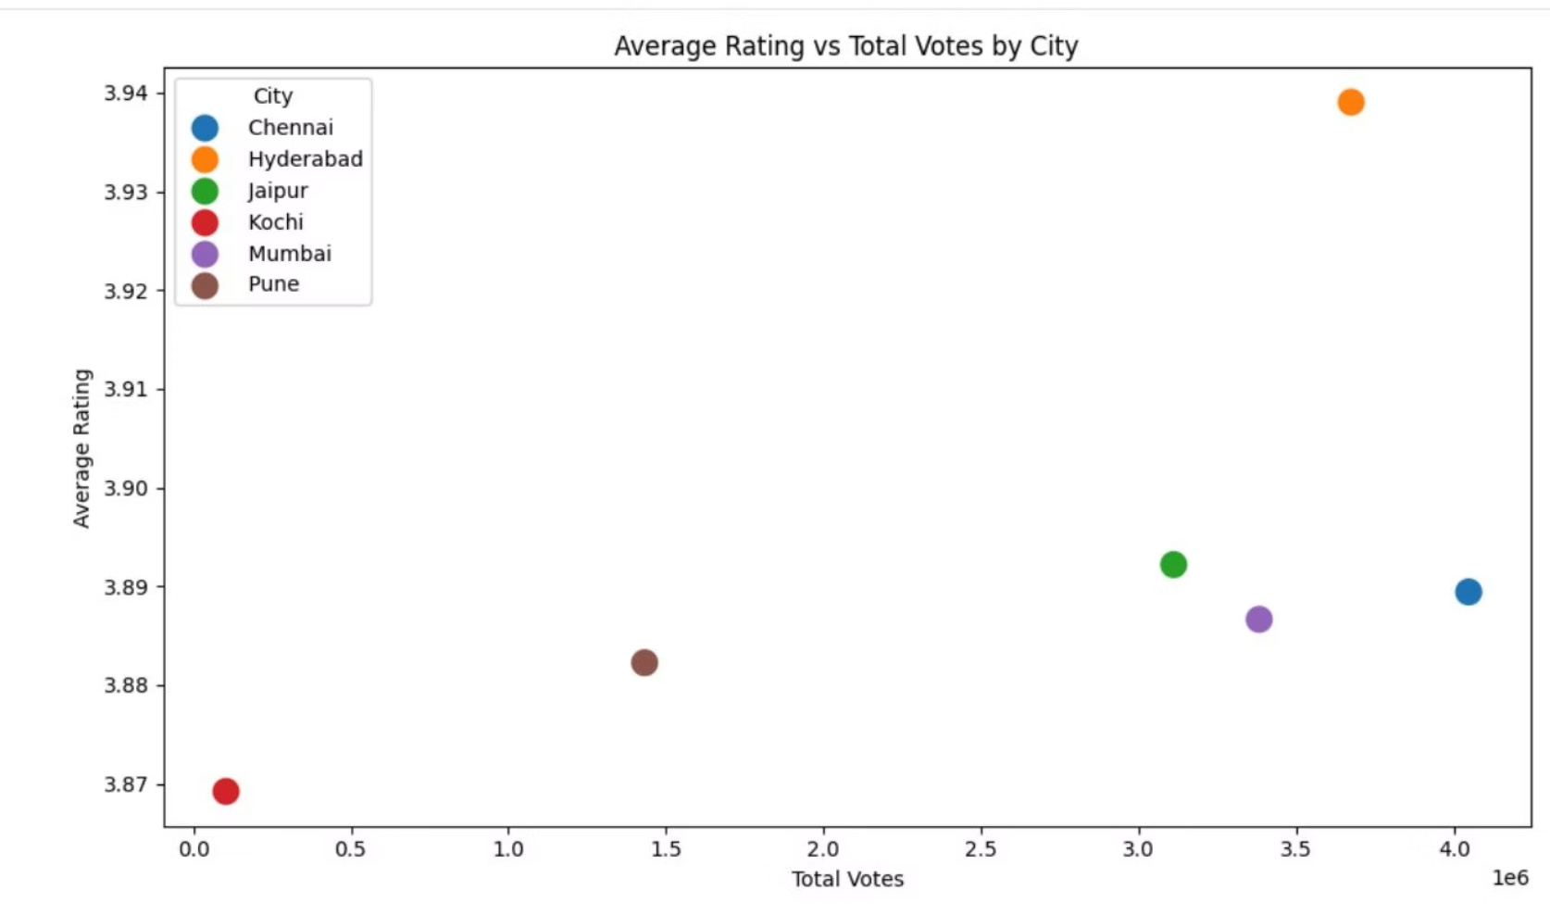
Geographic Market Assessment
City-level performance reveals minimal variation in average ratings across Chennai, Hyderabad, and Mumbai, all clustering around 3.9. This consistency suggests comparable quality standards and consumer expectations across major metropolitan markets.
However, the rating-votes scatterplot demonstrates that Hyderabad commands significantly higher total vote volumes, indicating greater overall market engagement and dining frequency. This elevated consumer activity suggests stronger market vibrancy despite similar quality levels.
The geographic analysis reveals that market selection should prioritize engagement metrics over rating differentials. Hyderabad's substantially higher voting activity, combined with comparable ratings to other metros, positions it as the most attractive market for new restaurant concepts seeking rapid customer acquisition and feedback loops.

Slide 16



Statistical Validation & Key Findings
Hypothesis Testing Results
Correlation Analysis
-44.43
<0.0001
T-Statistic
P-Value
22%
Independent samples t-test comparing dining vs. delivery ratings
Highly significant result rejecting null hypothesis of equal means
The statistical analysis provides robust evidence that dining and delivery ratings differ significantly across the dataset. With a t-statistic of -44.43 and p-value approaching zero, we reject the null hypothesis with extremely high confidence.
Rating Correlation
Weak positive correlation between dining and delivery ratings (r=0.22)
-24%
Vote Correlation
Weak negative correlation between dining and delivery votes (r=-0.24)
The near-zero correlations indicate that dining and delivery represent fundamentally different consumer experiences with distinct performance drivers. Success in one channel does not predict success in the other.
Statistical Conclusion
The data demonstrates that dining and delivery channels require separate optimization strategies. Operators should treat them as distinct business models with unique operational requirements, consumer expectations, and success metrics rather than assuming operational synergies.

Slide 17
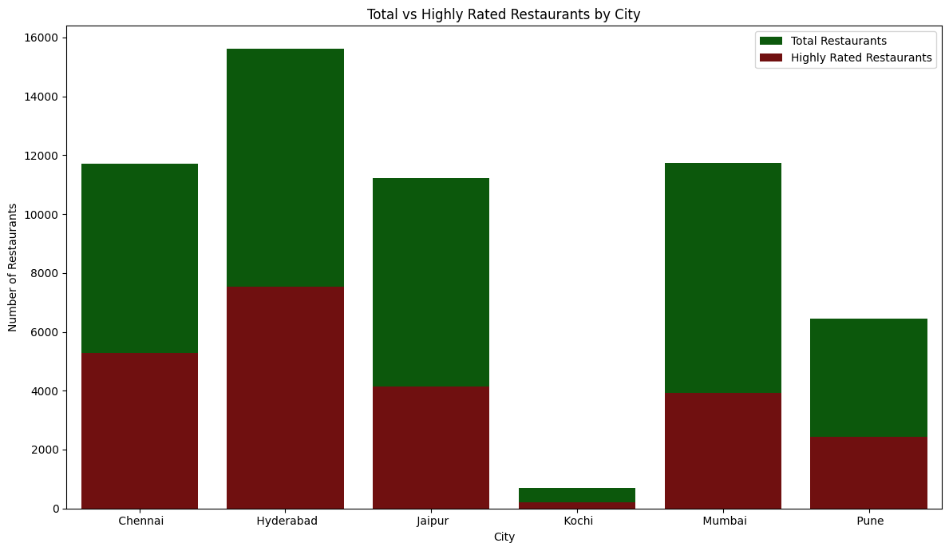
Competitive Landscape & Market Gaps
The stacked bar analysis compares total restaurant counts against highly-rated establishment density across cities. While all three metros show substantial restaurant populations, the proportion of highly-rated venues varies, revealing quality gaps and upgrade opportunities.
Market Entry Considerations
Hyderabad: Highest volume, most competitive, fastest feedback cycles
Hyderabad demonstrates the largest absolute number of both total and highly-rated restaurants, but the ratio suggests room for quality-focused entrants. Mumbai and Chennai show tighter distributions with proportionally fewer total restaurants, potentially indicating higher barriers to entry or more selective consumer bases.
Mumbai: Moderate density, quality-conscious consumers
Chennai: Similar to Mumbai with regional cuisine preferences

Slide 18
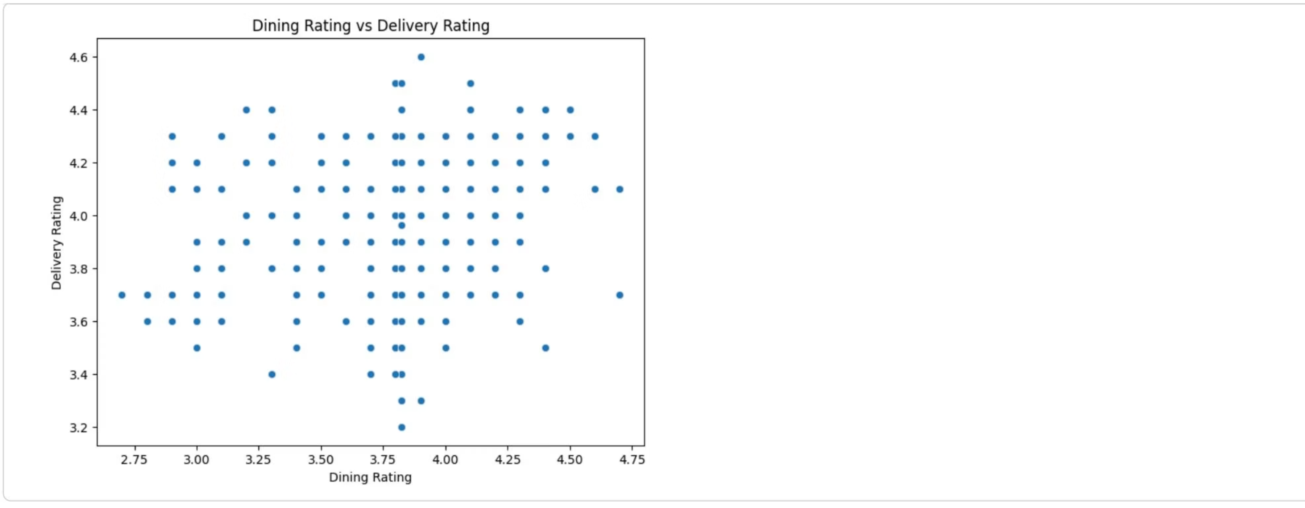
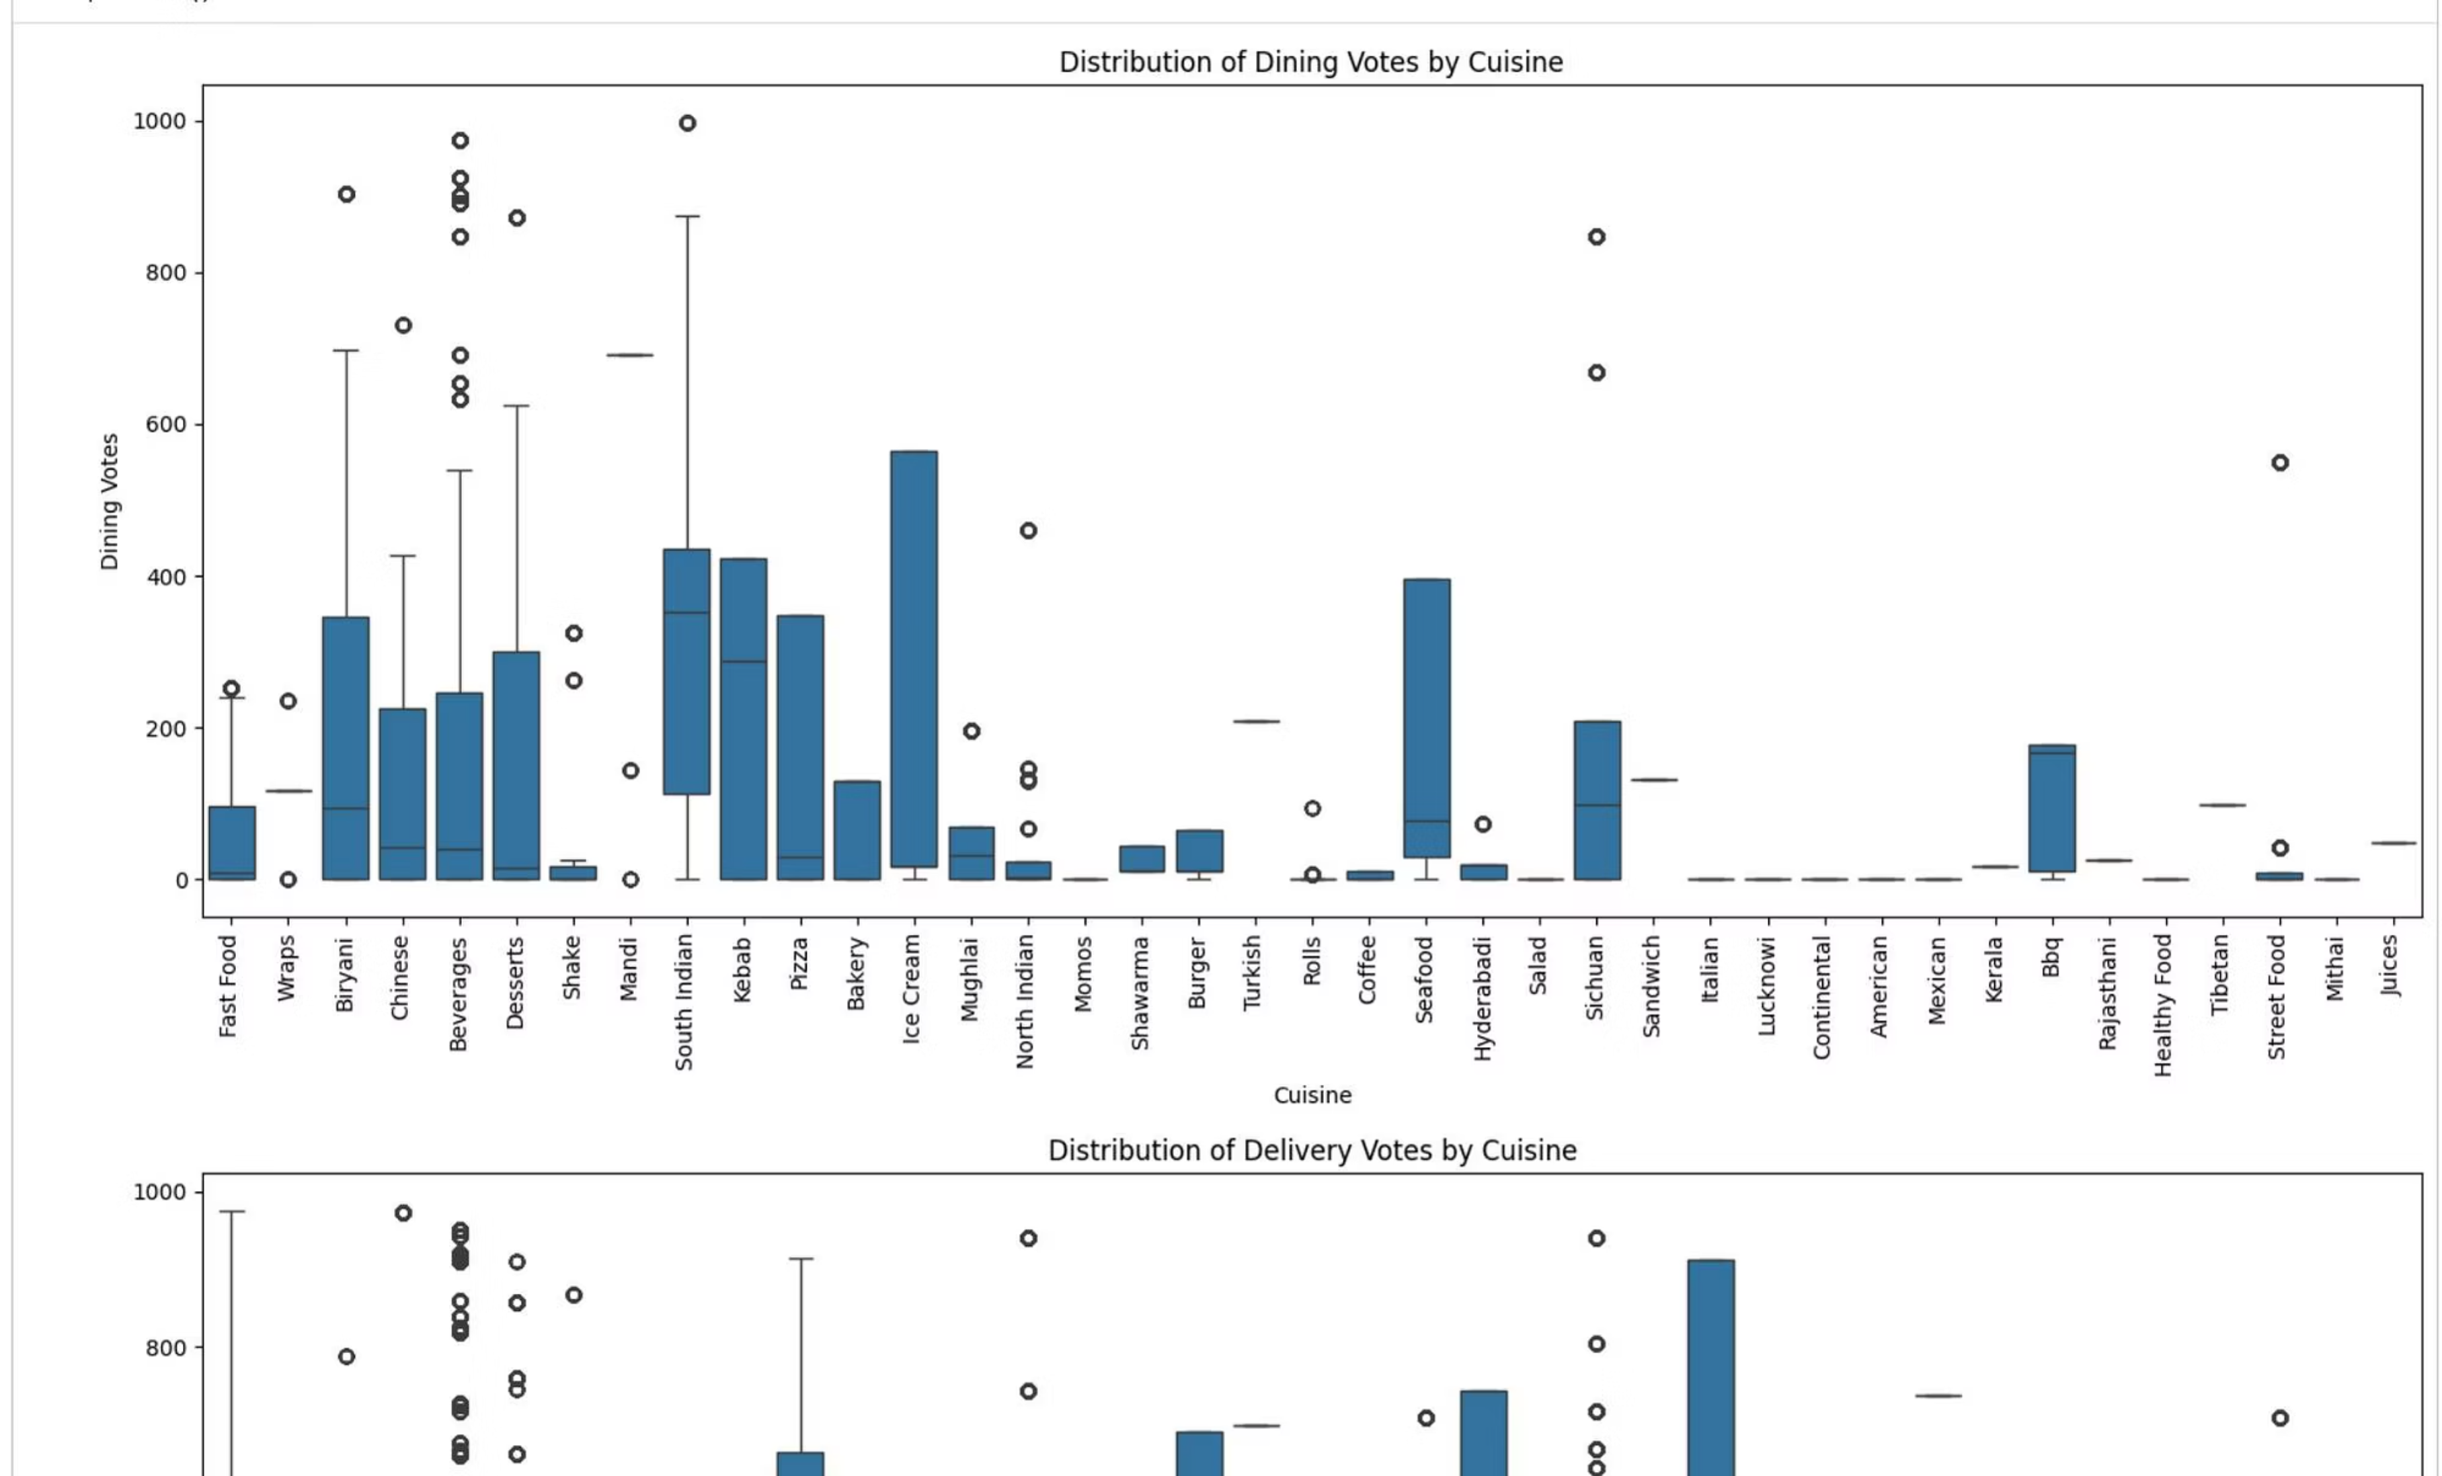
Service Channel Performance: Dining vs. Delivery
The dining-delivery rating scatterplot reveals a critical strategic insight: the two channels show weak correlation (r=0.22), indicating that excellence in one channel does not automatically translate to the other. Most restaurants cluster in the 3.5-4.5 rating band for both channels, but significant outliers exist.
01
02
03
Vote Distribution Patterns
Channel Specialization
Strategic Implication
Delivery votes show wider variance and higher median values across most cuisines, suggesting delivery has become the dominant engagement channel with greater consumer activity.
Certain cuisines perform asymmetrically: some excel in dining experience while underperforming in delivery, and vice versa. This indicates operationally distinct requirements for each channel.
New concepts should optimize for the dominant channel first rather than attempting dual-channel excellence initially. Delivery-first strategies appear more viable given voting patterns.

Slide 19







Strategic Recommendations
Optimal Cuisine Strategy
Geographic Priority
Channel Focus
Target mid-tier categories (Biryani, Bakery, BBQ) showing strong ratings (3.9+) with moderate competition. Avoid oversaturated Chinese/North Indian segments unless offering radical differentiation through fusion concepts or premium positioning.
Enter Hyderabad first due to highest consumer engagement metrics (total votes) despite similar quality levels across metros. The elevated activity provides faster learning cycles and customer acquisition opportunities.
Launch with a delivery-first strategy given higher vote volumes and wider engagement distribution in delivery channels. Optimize operations for delivery excellence before expanding to dine-in experiences, as the two channels show weak operational correlation.
Execution Priorities
Conduct localized consumer research in Hyderabad's high-engagement neighborhoods
Develop delivery-optimized menu focusing on travel-resistant items
Establish quality benchmarks targeting 4.0+ ratings within first 6 months
Monitor competitor pricing within selected cuisine category (±15% bandwidth)
Build feedback loops to rapidly iterate based on delivery rating patterns

Slide 20

Thank You!
Presented by Manobendra Ghosh
I appreciate your time and attention to our presentation on Zomato Restaurant Analytics: Data-Driven Market Opportunity Assessment.

